Slide 1
Provisioning Premium Capacity
© 2022 Microsoft All rights reserved.

Slide 2
Power BI Premium
Power BI Premium
Flexibility to license
by capacity
Consistent performance
Extending on-premises capabilities
Resources dedicated to your organization in the cloud
You are the resources admin
You are the resources admin
© 2022 Microsoft All rights reserved.

Slide 3
Pro vs Premium
Pro is about users
Per-user license
Gives access to sharing and collaboration features
Premium is about content
Dedicated capacity (think Virtual Machine)
Provides resources (Processor/Memory)
Can enable content to be shared with non-Pro users
Support for 10GB models, dataset can be refreshed up to 12GB
© 2022 Microsoft All rights reserved.

Slide 4
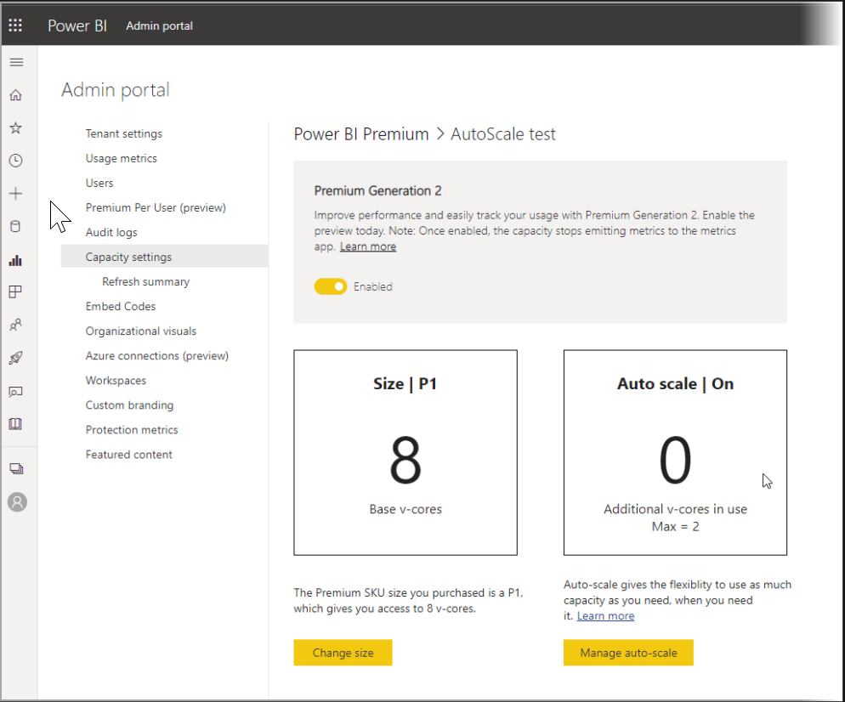
Premium Gen2
Per-user license in addition to by capacity
Enhanced performance
Greater scale
Improved metrics
Auto scale
Reduced management overload
© 2022 Microsoft All rights reserved.

Slide 5
Workspaces and Premium Gen2
Workspaces reside within capacities
Each Power BI user has a personal workspace known as My Workspace
Additional workspaces known as workspaces can be created to enable collaboration
By default, workspaces, including personal workspaces, are created in the shared capacity. When you have Premium capacities, both My Workspaces and workspaces can be assigned to Premium capacities.
Capacity administrators automatically have their “my workspaces” assigned to Premium capacities
© 2022 Microsoft All rights reserved.

Slide 6
Capacity Nodes for Premium Gen2
With Premium Gen2 and Embedded Gen 2, the amount of memory available on each node size is set to the limit of memory footprint of a single artifact, and not to the cumulative consumption of memory
For example, in Premium Gen2 P1 capacity, only a single dataset size is limited to 25 GB, in comparison to the original Premium, where the total memory footprint of the datasets being handled at the same time was limited to 25 GB
© 2022 Microsoft All rights reserved.

Slide 7
Refresh in Premium Gen2
Premium Gen2 and Embedded Gen 2 don't require cumulative memory limits
Concurrent dataset refreshes don't contribute to resource constraints
There is no limit on the number of refreshes running per v-core
The refresh of individual datasets continues to be governed by existing capacity memory and CPU limits
Schedule and run as many refreshes as required at any given time
© 2022 Microsoft All rights reserved.

Slide 8
Monitoring in Premium Gen2
Intent of monitoring in Premium Gen2 is to simplify monitoring and management of Premium capacities
Premium Gen2 aims to assure that everything is running properly and only alerts users if they must act
Premium Gen2 and Embedded Gen 2 only require monitoring a single aspect.
Premium Gen2 monitoring is a departure from the many metrics that the original version of Power BI Premium required
Premium Gen2 autoscales or throttles your interactive operations, based on your configuration settings if you exceed your CPU capacity
© 2022 Microsoft All rights reserved.

Slide 9
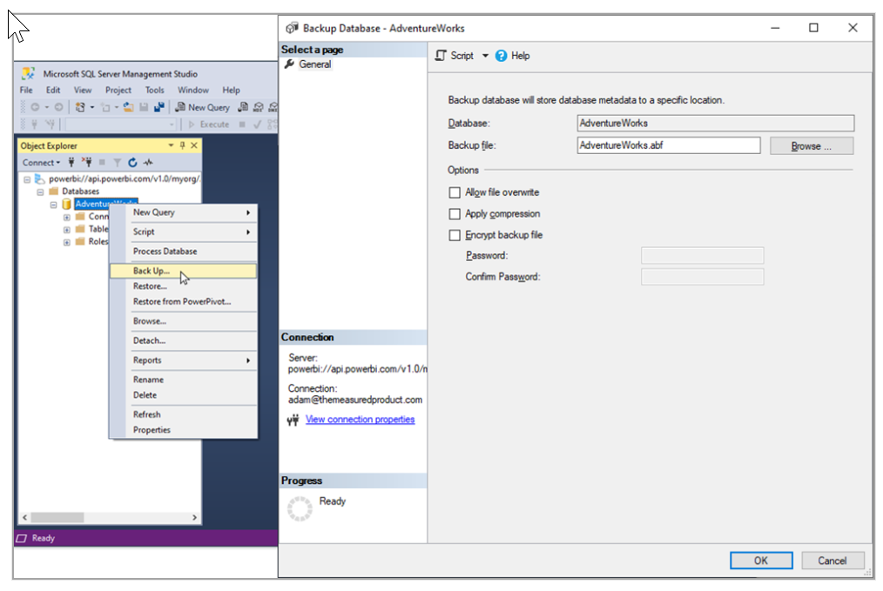
Backup & Restore Datasets with Power BI Premium
The Backup and Restore feature uses existing connections between Power BI and Azure
Use the Backup and Restore feature with Power BI datasets if you have a Power BI Premium or Premium Per User (PPU) license
You can use SQL Server Management Studio (SSMS), Analysis Services cmdlets for PowerShell, and other tools to perform backup and restore operations in Power BI using XMLA endpoints
You can also perform offline backups

Slide 10
Limitations in Premium Gen2
Client applications and tools that connect to and work with datasets on Premium Gen2 capacities through the XMLA endpoint require Analysis Services client libraries
There's a 225 second limitation for rendering Power BI visuals. Visuals that take longer to render, will be timed-out and will not display
Memory restrictions are different in Premium Gen2 and Embedded Gen 2
© 2022 Microsoft All rights reserved.

Slide 11
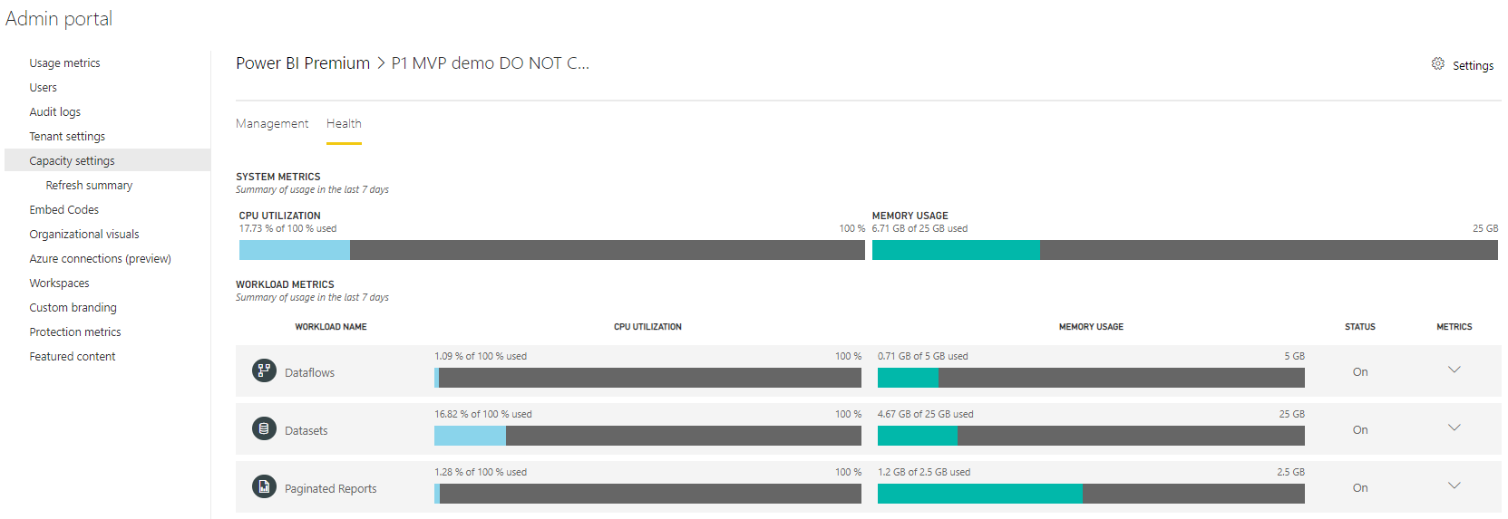
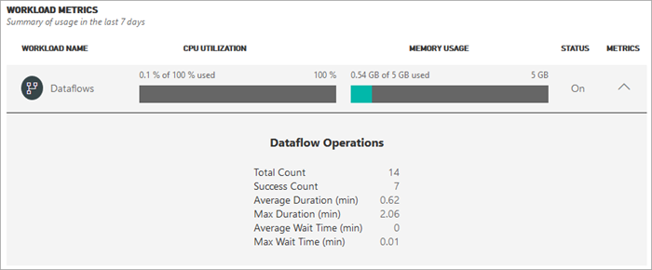
Premium Resource Management
Majority of resource issues are Modeling issues
Admin Portal provides ability to manage resources usage for capacity
© 2022 Microsoft All rights reserved.

Slide 12
Dedicated Capacity SKUs
Name | Virtual Cores | Memory | Model Refresh Parallelism
EM1/A1 | 1 | 0.5 | 0.5
EM2/A2 | 2 | 1 | 1
EM3/A3 | 4 | 2 | 2
P1/A4 | 8 | 4 | 4
P2/A5 | 16 | 8 | 8
P3/A6 | 32 | 16 | 16
P4/A7³ | 64 | 32 | 48
P5/A8³ | 128 | 64 | 96
© 2022 Microsoft All rights reserved.

Slide 13
What if my Capacity is Heavily Used?
© 2022 Microsoft All rights reserved.

Slide 14
Factors to consider for Performance & Capacity Management
Dataset size and data characteristics
How many different datasets will be used in parallel
How many refreshes in parallel
How frequent are the refreshes
How many visuals are on a page
How often are users interacting with visuals
How efficient are the measures in the dataset
© 2022 Microsoft All rights reserved.

Slide 15
Testing Premium Capacity
Controlled workload tests
Test should be repeatable (run several times)
Find a realistic scenario (include think time)
Consider scaling out
Load Testing Webinar: https://www.youtube.com/watch?time_continue=1860&v=C6vk6wk9dcw
Load Testing Webinar: https://youtu.be/UFbCh5TaR4w
Sample Power BI Web Test Recorder: https://testandattack.com/powerbisample/
© 2022 Microsoft All rights reserved.

Slide 16
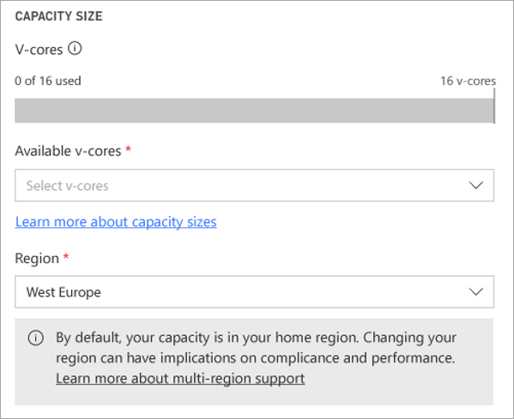
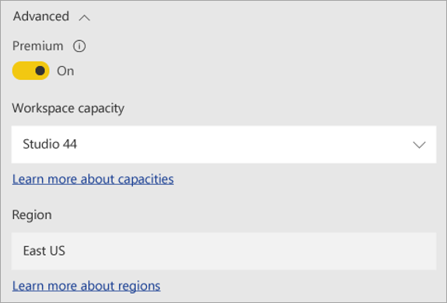
Supporting Multi-Geo
Helps multinational customers address regional, industry-specific, or organizational data residency requirements
Define the region for the capacity node
Set workspaces to the desired capacity
Content in that node will reside in that region
Multiple region content will need to be manually duplicated between workspaces
© 2022 Microsoft All rights reserved.

Slide 17
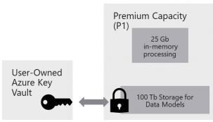
Bring Your Own Key
Power BI encrypts data at rest for all customers. With BYOK, organizations requiring additional controls over how their data is encrypted can exercise that control by configuring Power BI to use their own keys, stored in Azure Key Vaults, for data-at-rest encryption instead of Microsoft managed keys
BYOK encryption applies to Power BI Premium capacities only, and organizations can choose to associate different capacities with different keys and\or different key vaults
© 2022 Microsoft All rights reserved.

Slide 18
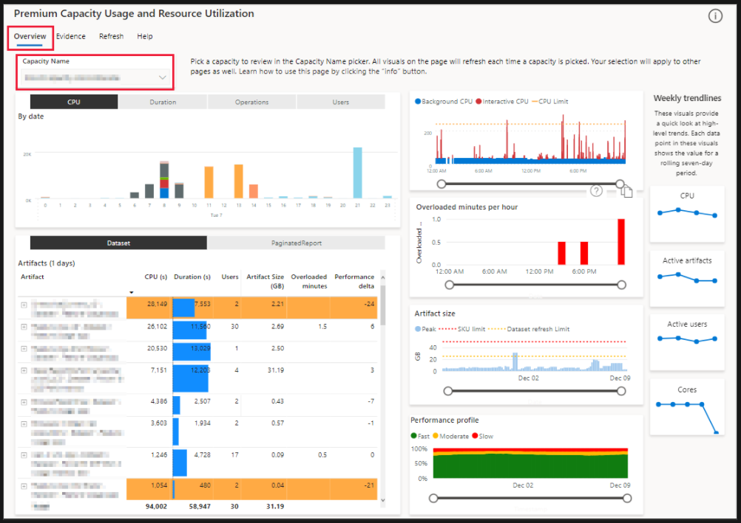
Premium Metrics App
The Gen2 metrics app has six pages:
Overview
Evidence
Refresh
Timepoint
Release Notes
Help
© 2022 Microsoft All rights reserved.

Slide 19
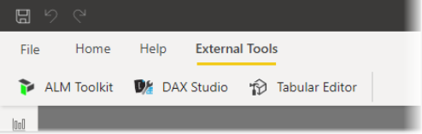
Monitor Individual Reports
External tools provide additional functionality and value to Power BI Desktop
Featured external tools
Tabular Editor - easily build, maintain, and manage tabular model
DAX Studio - DAX authoring, diagnosis, performance tuning and analysis
ALM Toolkit - used for application lifecycle management (ALM) scenarios
© 2022 Microsoft All rights reserved.

Slide 20
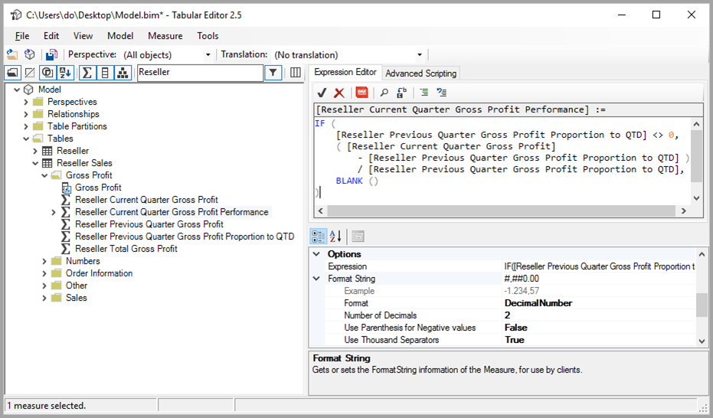
Tabular Editor
Lightweight editor
Easily build, maintain, and manage tabular model
Hierarchical view of the tabular model
Model objects organized by display folders
Supports multi-select property and DAX syntax highlighting
© 2022 Microsoft All rights reserved.

Slide 21
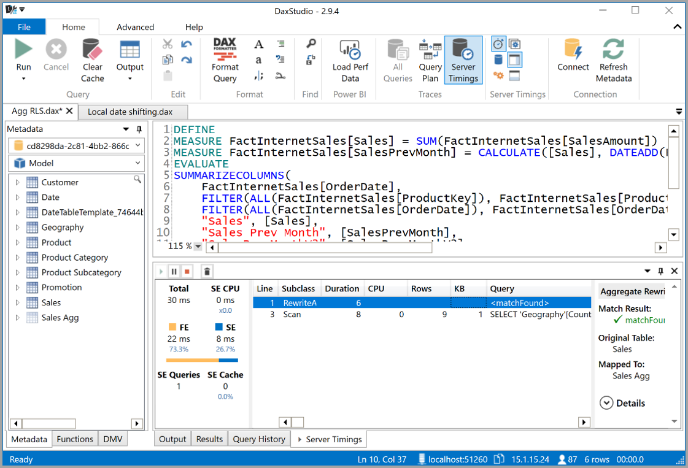
DAX Studio
Complete tool for DAX authoring
Great tool for diagnosis, analysis and performance tuning
Provides capabilities like
tracing
object browsing
query execution breakdowns
DAX syntax highlighting
DAX formatting
© 2022 Microsoft All rights reserved.

Slide 22
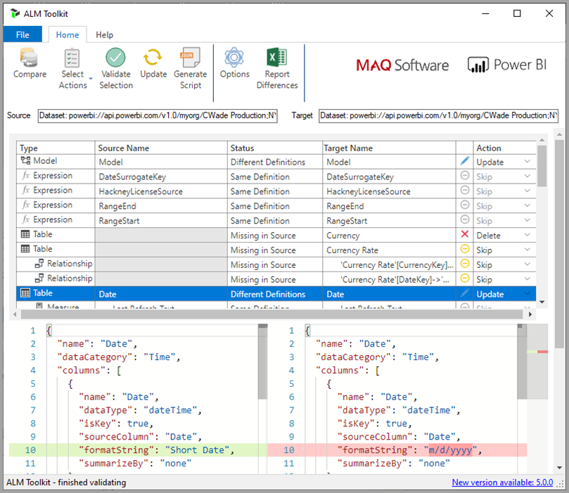
ALM Toolkit
Schema tool to compare Power BI datasets
Supports deployment across environments
Retains incremental refresh historical data
Reuse common definitions between datasets
Ability to diff/merge metadata files, branches and repos
© 2022 Microsoft All rights reserved.

Slide 23
Demo
Premium Capacity
© 2022 Microsoft All rights reserved.

Slide 24
Establishing Data Access Infrastructure
© 2022 Microsoft All rights reserved.

Slide 25
Data Connectivity Modes
 | Import | DirectQuery | Live/Exploration | Composite
Overview | ETL Data download | Select specific tables No data download Queries triggered from Report visuals | Explore source objects from Report surface No data download Queries triggered from Report visuals | Combine multiple data connections including direct query connections or import or a combination thereof
Supported Data Sources | All sources (>80 sources) | SQL Server Azure SQL Database Azure SQL Data Warehouse SAP HANA Oracle Teradata | SQL Server Analysis Services (Tabular & Multidimensional) | Following multidimensional data sources are NOT supported SAP HANA and BW SAP Business Warehouse SQL Server Analysis Services Power BI Datasets
Max # of data sources per report | Unlimited | One | One | Unlimited
Data Transformations | All transformations (100’s) | Partial support (varies by data source) | None | All transformations for import queries Partial support for DirectQuery (by data source)
Mashup Capabilities | Merge (Joins) Append (Union) Parameterized queries | Merge (Joins) Append (Union) | None | Import capabilities for imported queries Direct Query capabilities for Direct queries
Modeling Capabilities | Relationships Calculated Columns & Tables Measures Hierarchies | Calculated Columns Measures Change Column Types | None | Relationship between queries from different data sources
© 2022 Microsoft All rights reserved.

Slide 26
Personal Gateway vs Enterprise Gateway
 | On-premises Data Gateway (Personal Mode) | On-premises Data Gateway (aka Enterprise Gateway)
Target Persona | Business analyst sets up and uses the gateway for her data sources only | BI Admins set up the gateway for their department/ company Multiple users use the gateway setup by the admins
Features | Import with scheduled refresh | Direct query and scheduled refresh
 | No additional data source configuration to set up a refresh | Gateway admin needs to configure each data source explicitly
 | Data source connections managed per user | Central data source management and access control
Services supported | Power BI | Power BI, PowerApps, Microsoft Flow, Azure Logic Apps, Azure Analysis Services, Power Query Online with CDS
© 2022 Microsoft All rights reserved.

Slide 27
How Data is Refreshed
 | Import (cached mode) | Direct Query or Live connection
Refresh frequency | Scheduled – hourly (8x a day) Premium allows for 48x a day | Real-time
Refresh Performance | No noticeable delay since data is already cached | Depends on how fast the data source is as queries are executed in real-time
Data storage in Power BI | Since it is cached mode, data is stored in the cloud | No data is stored in Power BI. Data is always on-premises*
Data size | Current limit of 1GB (compressed) per model; Up to 10GB with Premium | The on-premises database is the limit; no Power BI limitation
Security | Can create row-level security on the Power BI dataset | Re-use on-prem row level security (for Analysis Services, additional SSO based on Kerberos)
Data sources | All on-prem data sources supported can be used in import mode | Select data sources
© 2022 Microsoft All rights reserved.

Slide 28
Gateway Network Requirements
URI | Outbound Ports | Gateway Installation | Gateway Runtime | Purpose
*.download.microsoft.com | 80 | X |  | Download of Personal/Data Gateway installer package
*.msftncsi.com | 443 | X |  | Internet/Windows connectivity diagnostics check
*.login.windows.net login.microsoftonline.com *.microsoftonline-p.com | 443 | X |  | Azure AD login for PowerBI.com
*.powerbi.com | 443 | X |  | Configuration and registration of Gateway with Power BI & Gateway Management service
*.servicebus.windows.net | 5671-5672 9350-9354 | X | X | Tcp-Mode of the gateway for runtime communication for queries & results (encrypted, compressed).
*.servicebus.windows.net | 443 | X | X | Https-Mode of the gateway for runtime communication for queries & results (encrypted, compressed).
© 2022 Microsoft All rights reserved.

Slide 29
Where to Install Gateway
Recommendation
Start with an 8-core machine. Others: https://docs.microsoft.com/en-us/data-integration/gateway/service-gateway-install#recommended
Keep an eye on your performance counters https://powerbi.microsoft.com/en-us/documentation/powerbi-gateway-onprem-tshoot/#performance
Depending on your usage, you can decide to scale up or down
Gateway doesn’t have to run on the same machine as the data source
Hardware needs depend on the usage scenarios for the gateway:
Frequency and data volume of data model refreshes in Power BI
DirectQuery: number of concurrent users, types of visualizations for interactive querying, whether RLS is used, number of pinned dashboard tiles over DirectQuery/LiveConnect keep updating in the background
© 2022 Microsoft All rights reserved.

Slide 30
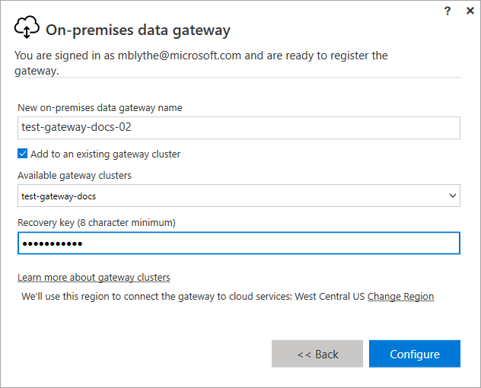
Establishing High Availability Gateways
Every gateway is part of a cluster
During install create a new cluster or join existing cluster
Recovery key is required
Must be admin of original gateway
© 2022 Microsoft All rights reserved.

Slide 31
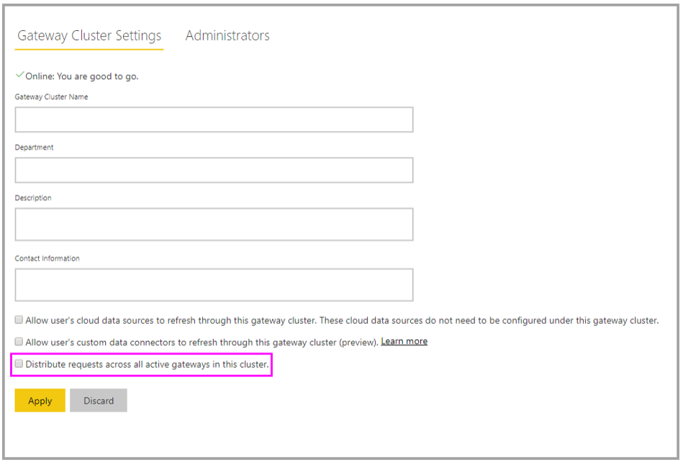
Establishing Load Balancing of Gateways
Distribute traffic evenly across gateway members in a cluster
© 2022 Microsoft All rights reserved.

Slide 32
Gateway Performance Monitoring (Docs)
Configuration enabling Query execution and System Counters log files
Out-of-the-box Power BI template for visualization
Query Execution Log
Query Execution Aggregation Log
System Counter Aggregation Log
© 2022 Microsoft All rights reserved.

Slide 33
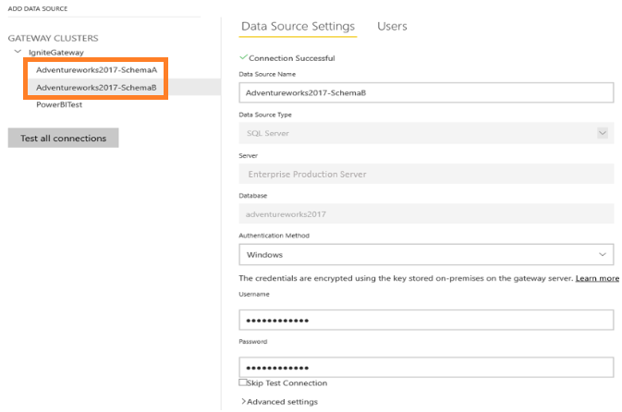
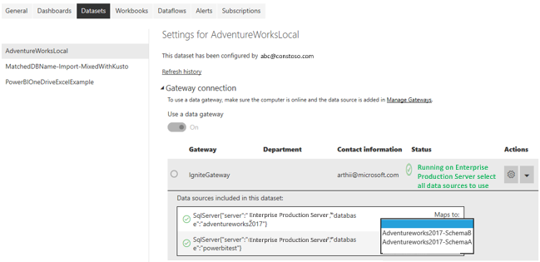
Multiple Data Sources per Gateway
Ability to create multiple data sources entries for the same data source with different credentials
Power BI dataset has ability to select from the available data source entries
© 2022 Microsoft All rights reserved.

Slide 34
Manage Gateway Users
For On-premises data gateway in standard mode, users can be added in any of the following three categories
Admin:
Administrators have full control of the gateway
Can add other admins
Can create and manage data sources
Can create and manage users
Delete gateway
Connection creator:
Users who can create connections/data sources
Users can test if gateway is online or offline
Users cannot manage or update the gateway
Users cannot add or remove other users
Connection creator with sharing:
Users who can create a connections and data sources on the gateway
Users can share the gateway when sharing an app
Use this permission for users who need to share apps with other users or with the organization
Cannot remove users from the gateway
© 2022 Microsoft All rights reserved.

Slide 35
SSO User Mapping Options
Your local Active Directory accounts match/are synchronized to Azure Active Directory. https://powerbi.microsoft.com/en-us/documentation/powerbi-gateway-enterprise-manage-ssas/#usernames-with-analysis-services
Manual User Re-Mapping (UPN Mapping, SSAS Only)
https://docs.microsoft.com/en-us/power-bi/service-gateway-enterprise-manage-ssas#map-user-names-for-analysis-services-data-sources
Although manual mapping of each user might be possible using manual mapping, it can become too time-consuming and hard to maintain if there are too many rules
Especially, when pattern matching does not suffice:
User Account names are different between AAD and on-prem AD
Example: firstName.lastName@contoso.com → Alias@corp.on-prem.contoso
On-prem Active Directory Property Lookup to remap UPNs to AD users
https://docs.microsoft.com/en-us/power-bi/service-gateway-enterprise-manage-ssas#synchronize-an-on-premises-active-directory-with-azure-ad
© 2022 Microsoft All rights reserved.

Slide 36
AD User Mapping with Custom Property Lookup
Power BI
Power BI Service:
For each query by a Power BI AAD user to on-premises SSAS servers, passes along UPN string: “firstName.lastName@contoso.com”
Note: any manual UPN user mappings defined in the Power BI data source configuration are still applied before sending the username string to the on-premises data gateway
Cloud
On-premises Data Gateway with configurable Custom User Mapping:
Find Active Directory to search (automatic, or configurable)
Lookup e.g. ‘Email’ attribute of AD Person based on incoming UPN string (“firstName.lastName@contoso.com”) from Power BI Service
If the AD Lookup fails, attempts to use the passed-along UPN
If AD Lookup succeeds, retrieve ‘UserPrincipalName’ of that AD Person
Pass ‘UserPrincipalName’ email as EffectiveUserName to SSAS: e.g. “Alias@corp.on-prem.contoso”
On-premises
On-premises data sources
SQL Server
SAP HANA
Tera-data
Impala *
SAP BW
*
Oracle
*
SQL Server Analysis Services
© 2022 Microsoft All rights reserved.

Slide 37
Demo
Gateway
© 2022 Microsoft All rights reserved.

Slide 38
Broadening the Reach of Power BI
© 2022 Microsoft All rights reserved.

Slide 39
Embedding Scenarios
Publish to web
SharePoint Online Web Part
REST API / Custom development
Embedding for your organization
Embedding for your customers
Embed in Microsoft Teams
Embed in PowerApps
Power BI Embedded
© 2022 Microsoft All rights reserved.

Slide 40
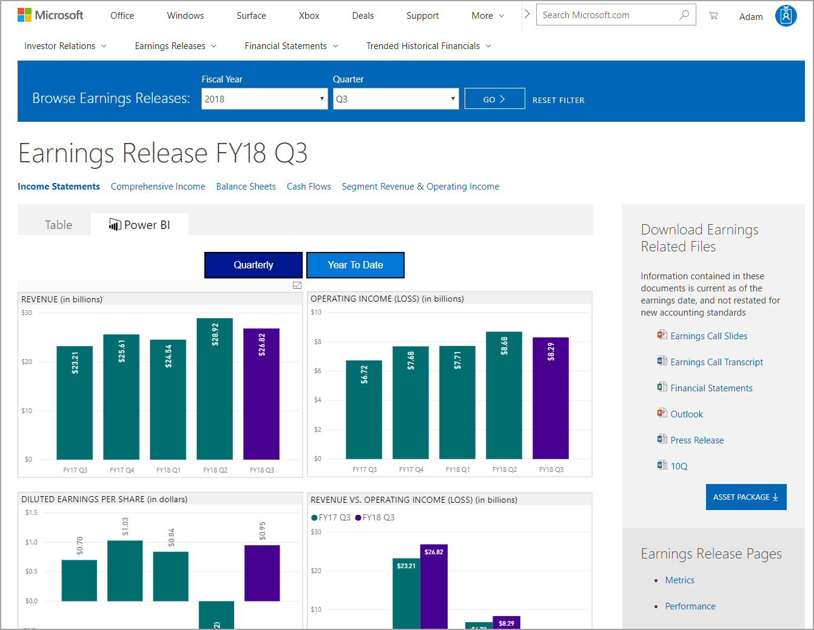
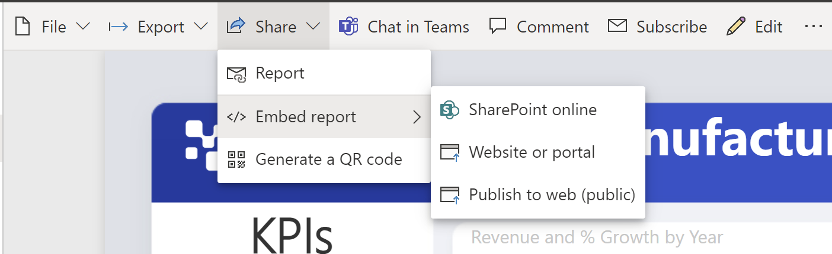
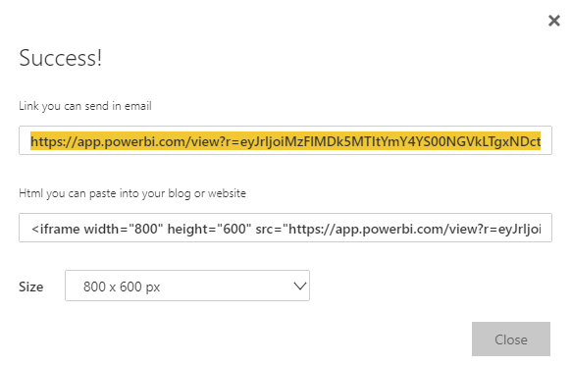
Publish to the Web
Generates Embed code
No authentication required (not secure!!!)
Great for Public Relations!
© 2022 Microsoft All rights reserved.

Slide 41
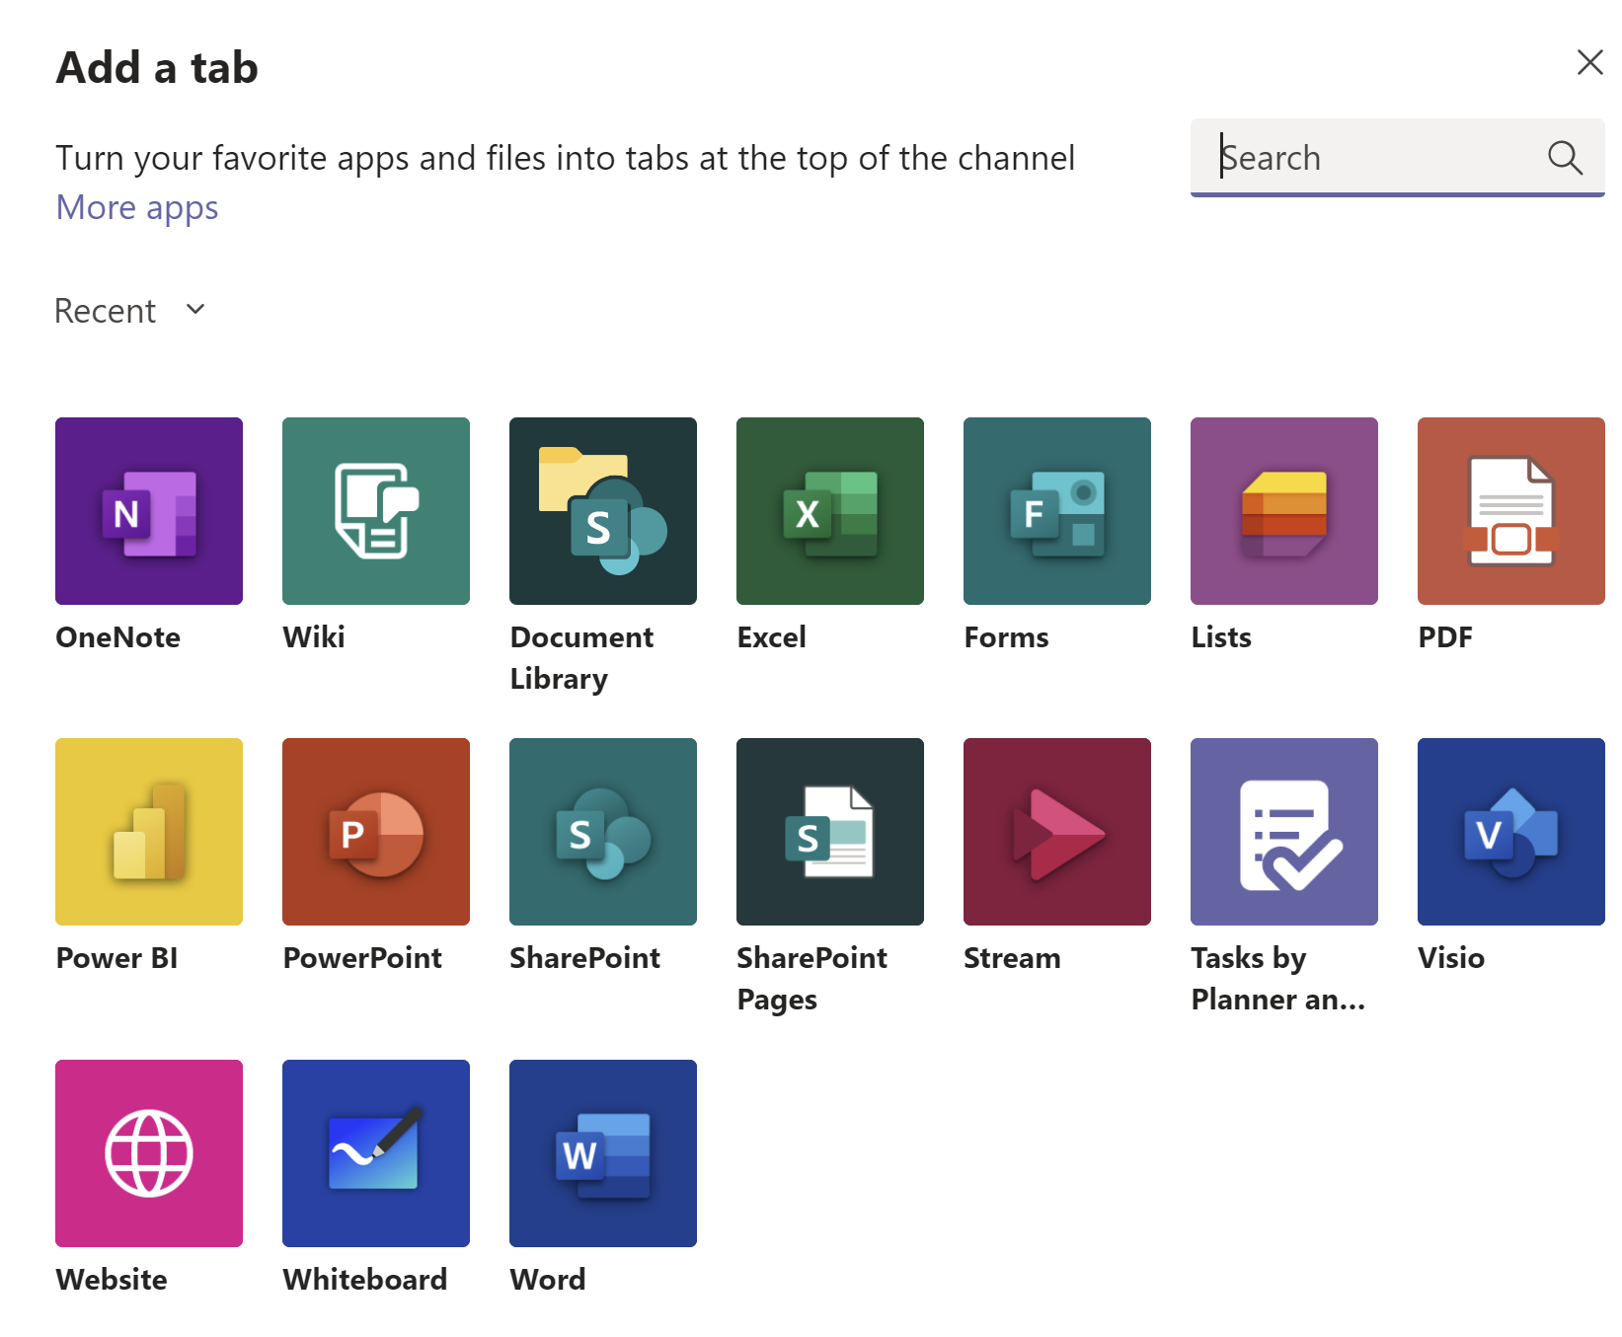
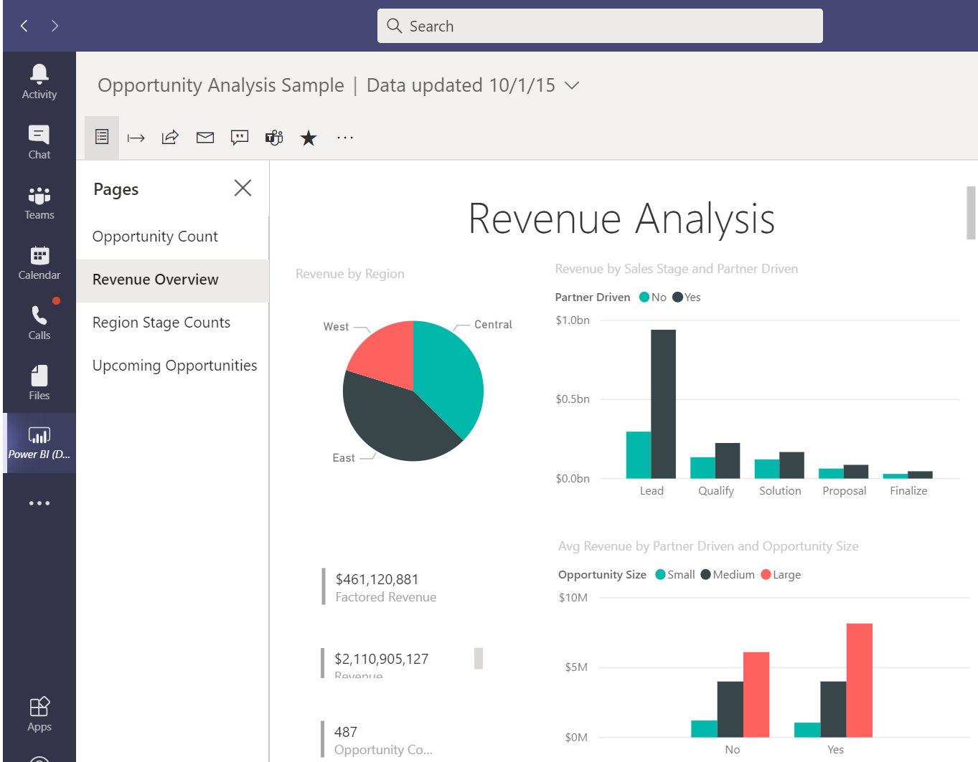
Embed in Teams
In your Microsoft Teams channel, you just tap the + sign, then add Power BI as a tab in your channel
Microsoft Teams automatically detects all the reports in your Power BI groups and in My Workspace. You can choose which ones to show in the Power BI tab in your channel
© 2022 Microsoft All rights reserved.

Slide 42
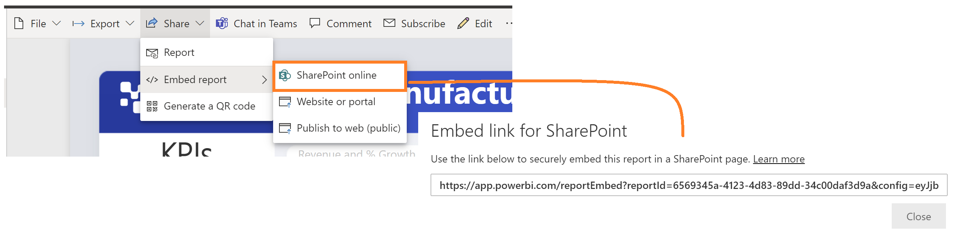
SharePoint Online Web Part
Allows easy embedding of report in SharePoint Online
No need for coding knowledge
Does not work with On-Premises SharePoint
Relies on organization login
© 2022 Microsoft All rights reserved.

Slide 43
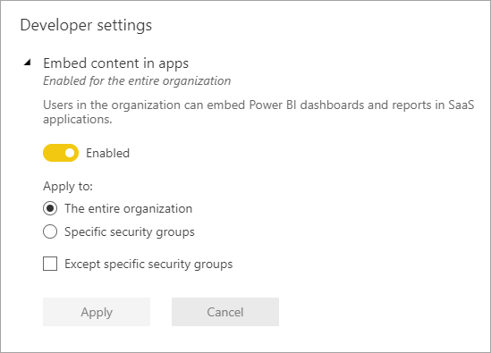
Tenant Settings for Developers
Embed content in apps setting must be enabled
Use this setting to block embedding usage
© 2022 Microsoft All rights reserved.

Slide 44
REST API/Custom Development
Azure Active Directory REST APIs
.NET SDK
JavaScript SDK
Power BI REST APIs
Azure AD Libraries for multiple platforms
© 2022 Microsoft All rights reserved.

Slide 45
Available NuGet Packages
Azure AD Authentication Library
Microsoft.IdentityModel.Clients.ActiveDirectory
Power BI .NET SDK
Microsoft.PowerBI.Api
JavaScript SDK
Microsoft.PowerBI.JavaScript
Dependent packages will be imported
© 2022 Microsoft All rights reserved.

Slide 46
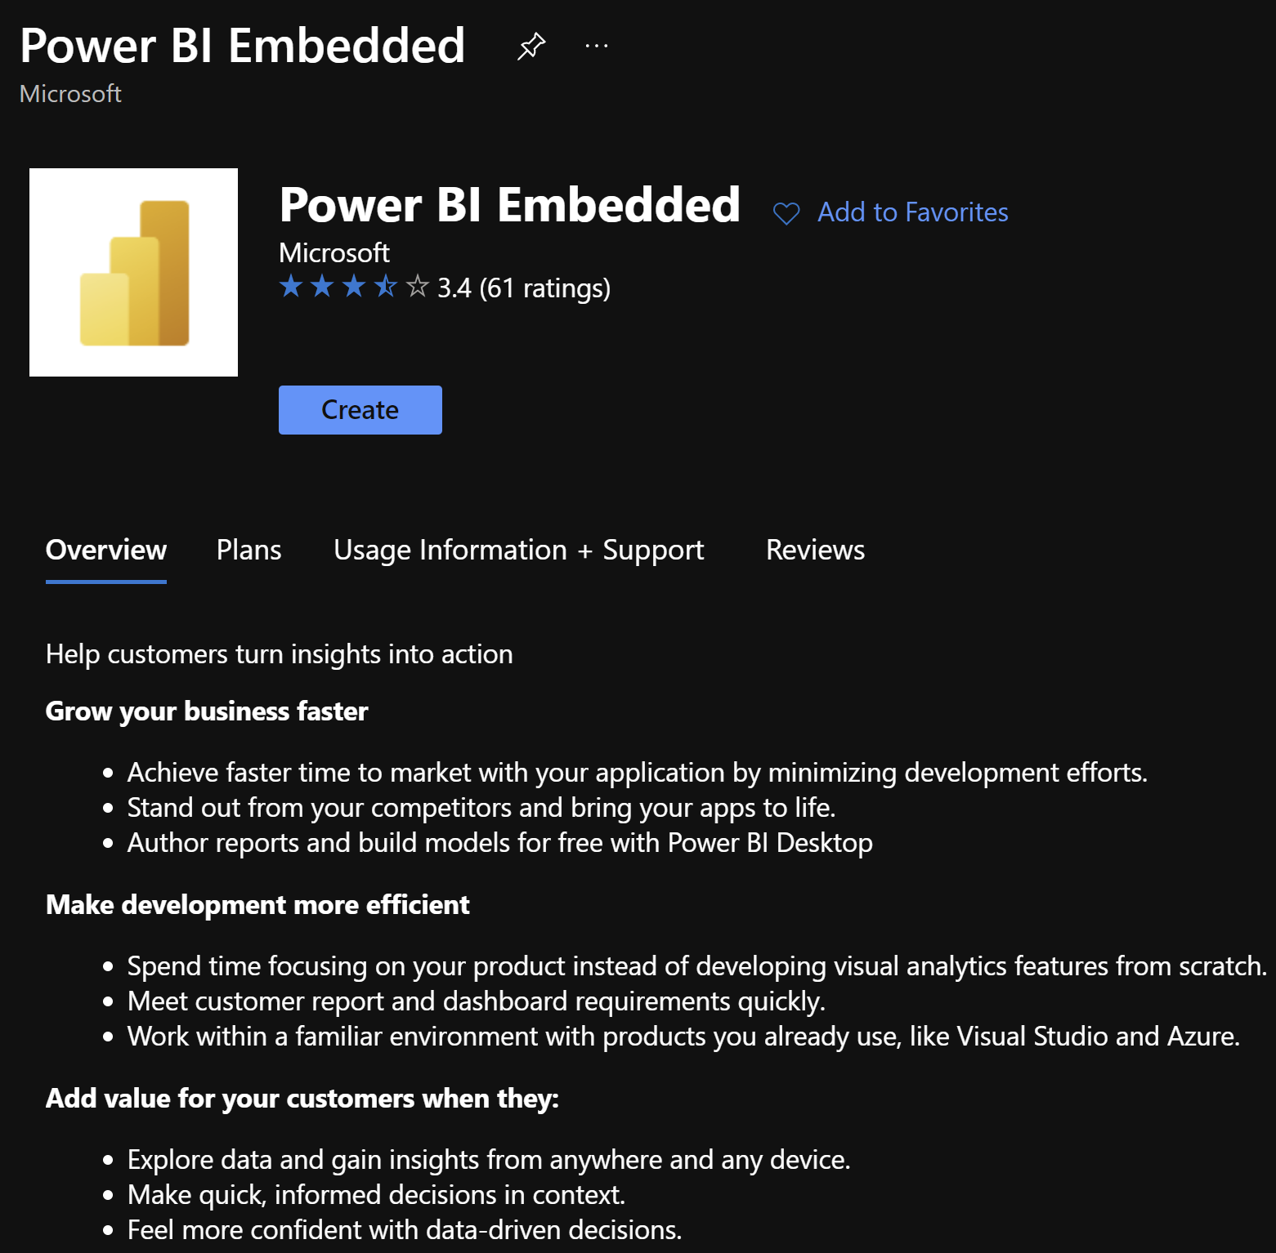
Provisioning a Power BI Embedded Capacity
Created in Azure Portal
Need to be signed in with user in Power BI Tenant!
Need an active Azure Subscription
Signed in user is default Capacity Admin
Can add other users
A SKUs map to EM/P SKUs
A1 = EM1
A4 = P1
A6 = P3
© 2022 Microsoft All rights reserved.

Slide 47
Certificate revocation check for web connections
Used to Strengthen the security of web connections to protect data
Certificate revocation info status | Comprehensive Check | Basic Check | None
Revoked
Unknown
Not revoked
Registry configuration:
Value | Mode | Configuration
0 | Basic | Certificates that have an unknown revocation status will be accepted. Equivalent to enabling the checkbox in Power BI Desktop)
1 | Disabled | Ignore all revocation checks. Equivalent to disabling the checkbox in Power BI Desktop)
2 | Comprehensive | Require certificates to not be revoked.
© 2022 Microsoft All rights reserved.

Slide 48
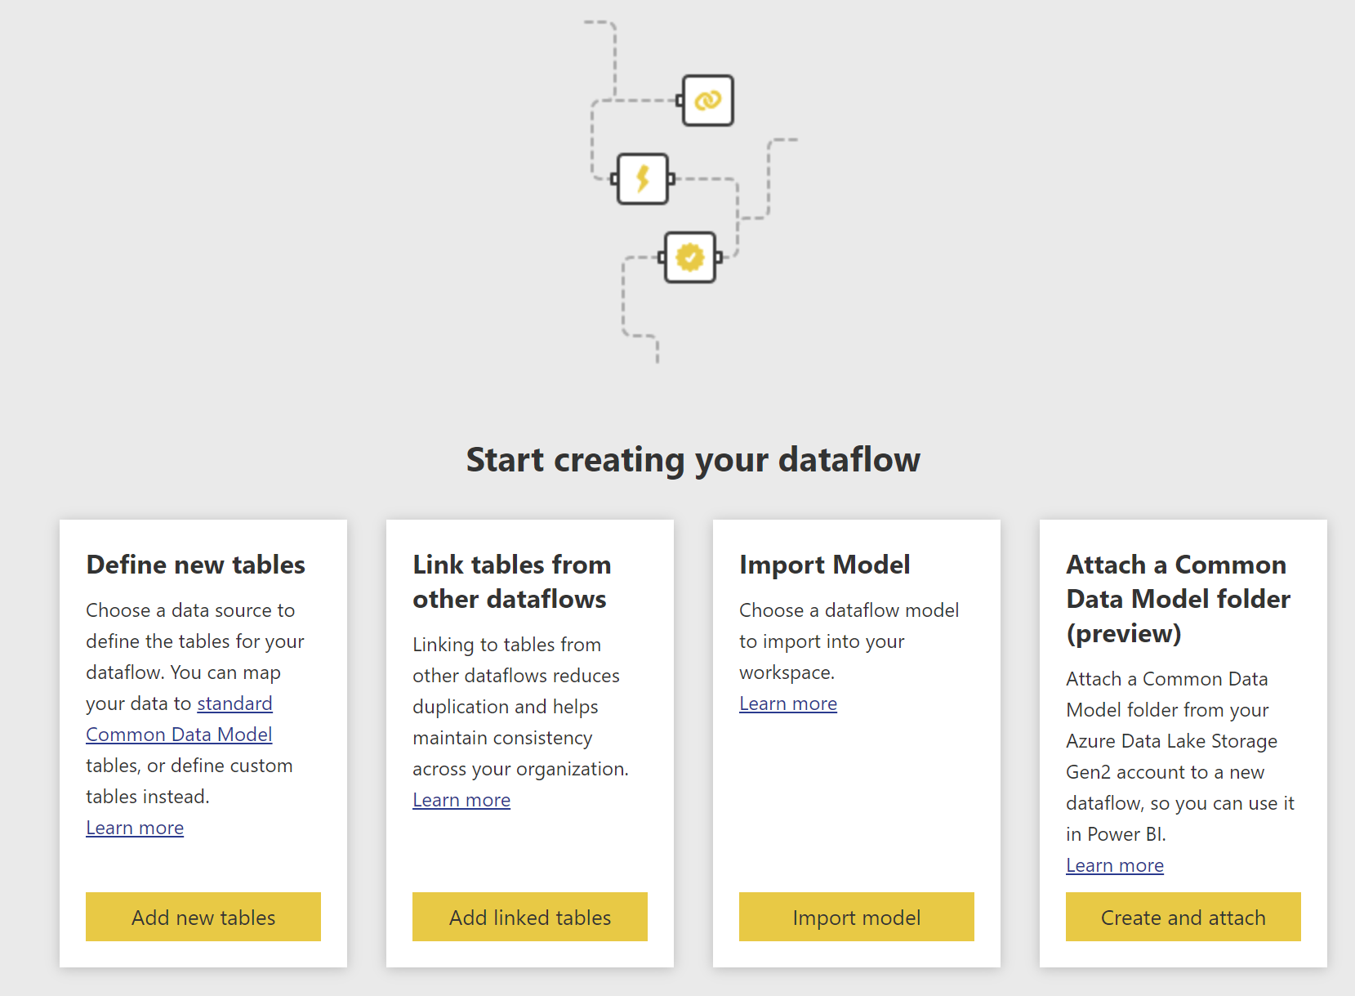
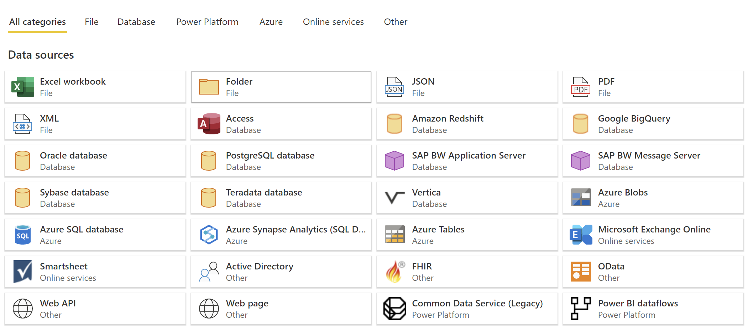
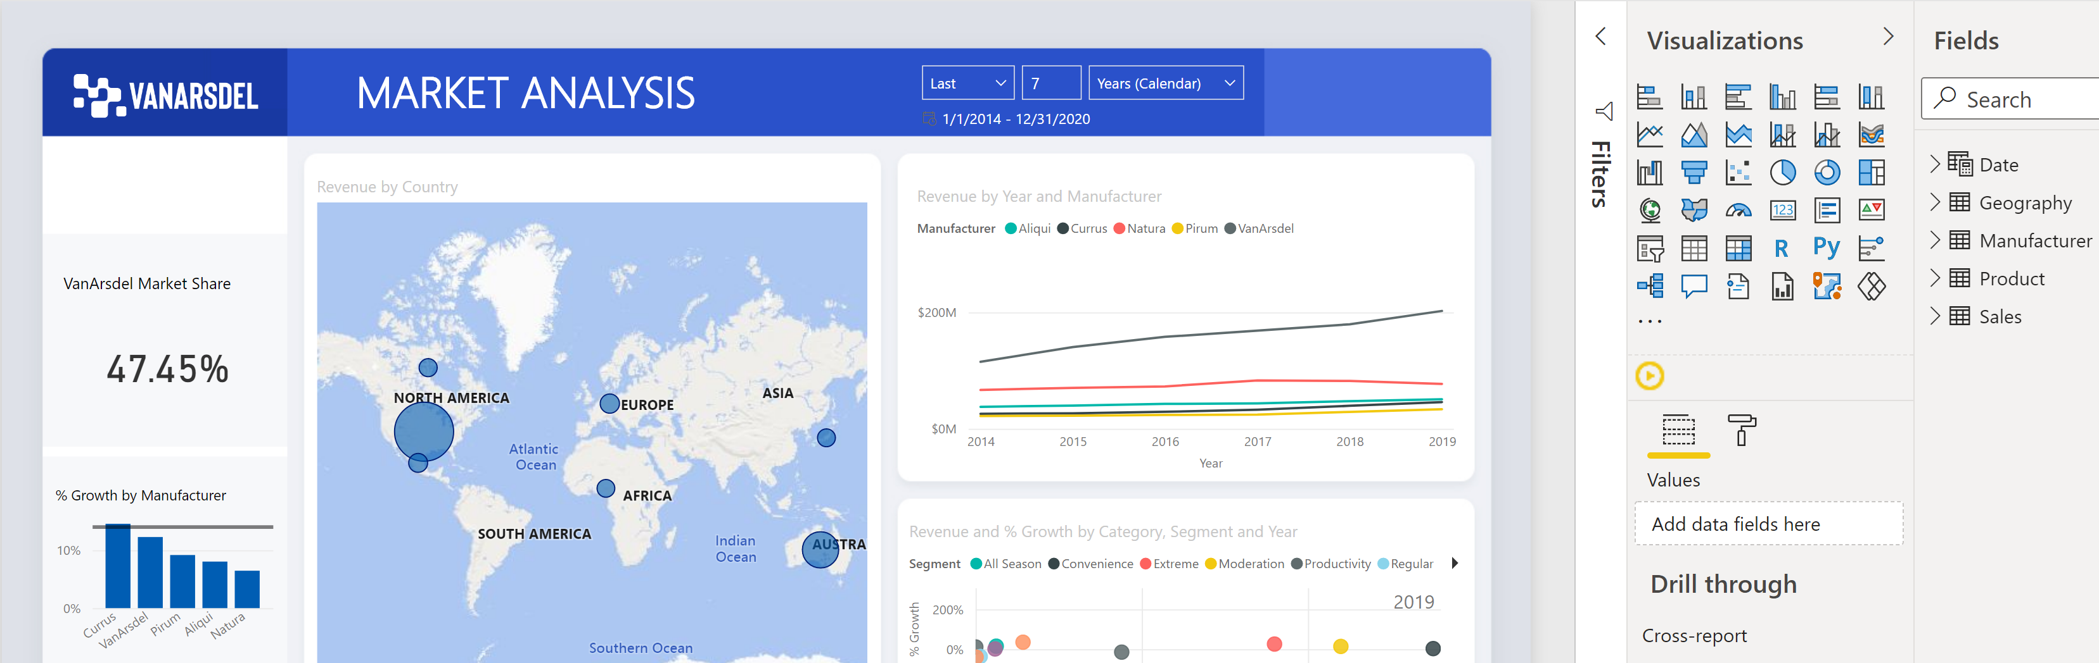
Dataflow
Dataflow is an advanced data preparation tool
It is a collection of entities
Managed in Power BI Service
Three main steps:
Author dataflow
Schedule refresh
Build dataset using Power BI Desktop
© 2022 Microsoft All rights reserved.

Slide 49
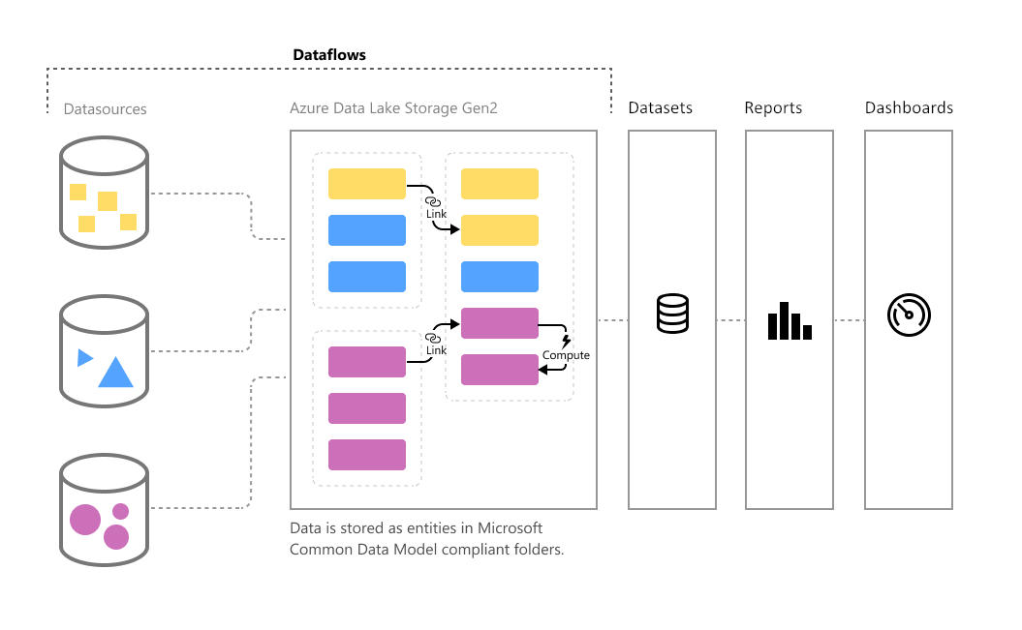
Dataflow
Dataflows are created and managed in workspaces by using the Power BI service
Data is stored as entities in the Common Data Model in Azure Data Lake Storage Gen2
Ingest data from on-premises or cloud data sources
Ability to map, edit and extend standard entities
Ability to create custom entities
Create Power BI datasets using dataflow
Ability to schedule refresh
© 2022 Microsoft All rights reserved.

Slide 50
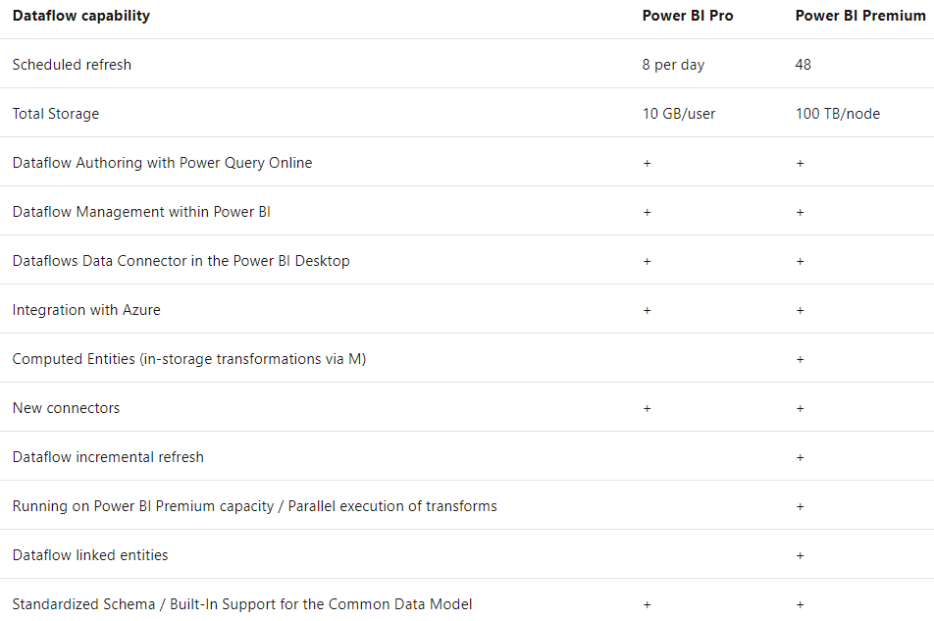
Dataflow Capabilities on Power BI Premium
© 2022 Microsoft All rights reserved.

Slide 51
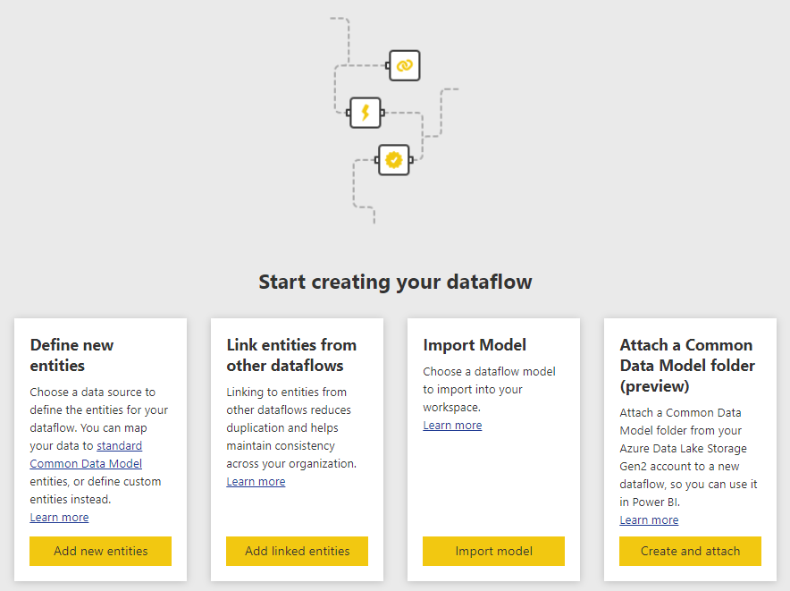
Dataflow
Define new entities
Link entities from other dataflows
Import model
Attach a Common Data Model folder
Require Storage Blob Data Owner role of the storage account
Require Read Access and Execute Access ACLs on both the CDM folder itself and any files or folders within it
© 2022 Microsoft All rights reserved.

Slide 52
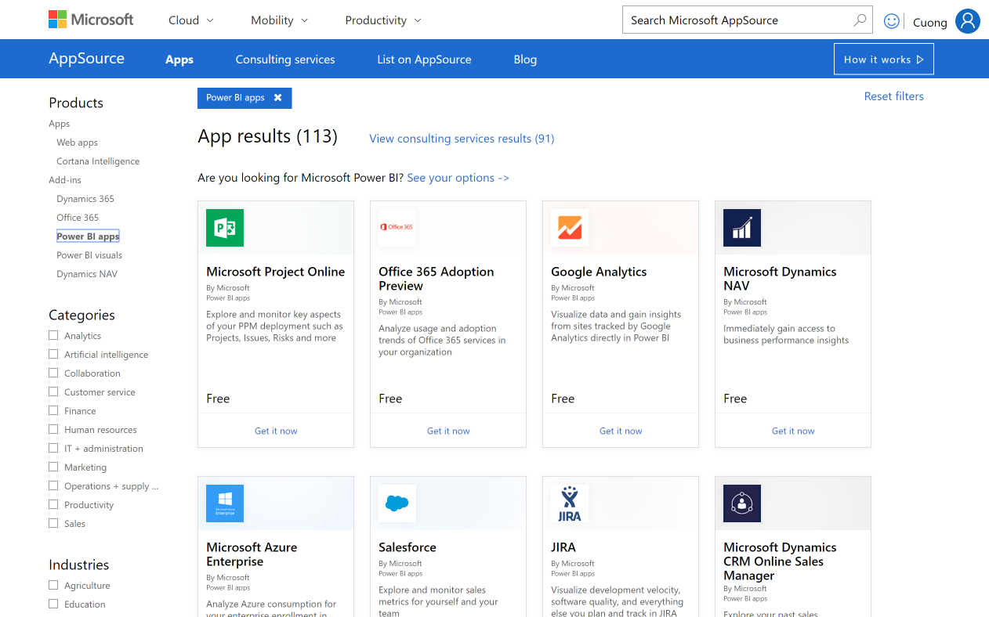
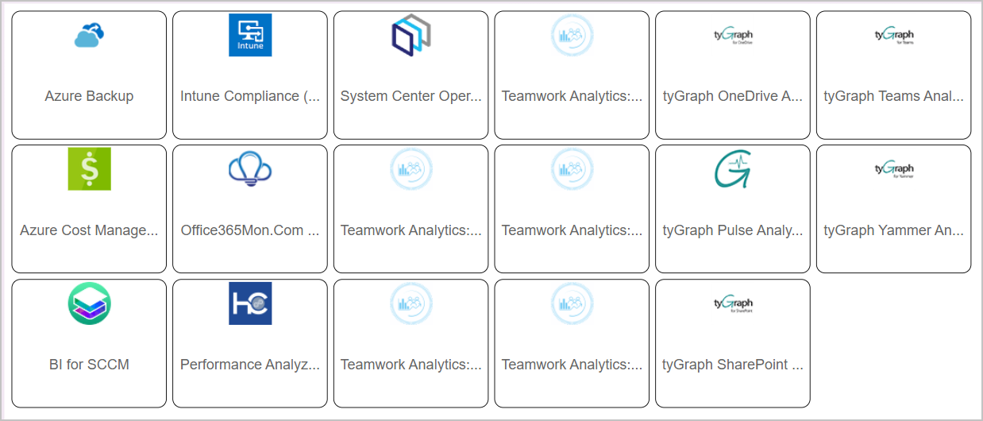
Template Apps – Install Packaged
Insights for your organization or for usage monitoring
© 2022 Microsoft All rights reserved.

Slide 53
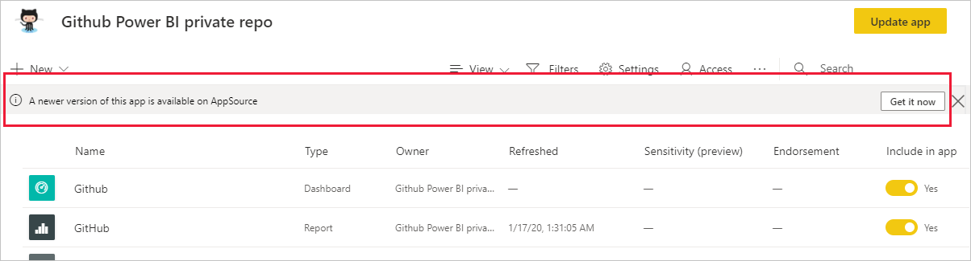
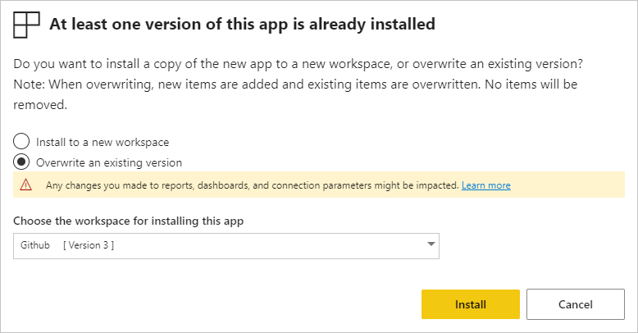
Template App – Update App
© 2022 Microsoft All rights reserved.

Slide 54
Template Apps
Template apps
PRO user experience: Customize everything, once installed in your tenant, it’s like any other content you have in Power BI
Get continuous updates to content you installed either side by side or in place overwrite (WIP)
As an administrator define who in the organization can install apps
© 2022 Microsoft All rights reserved.

Slide 55
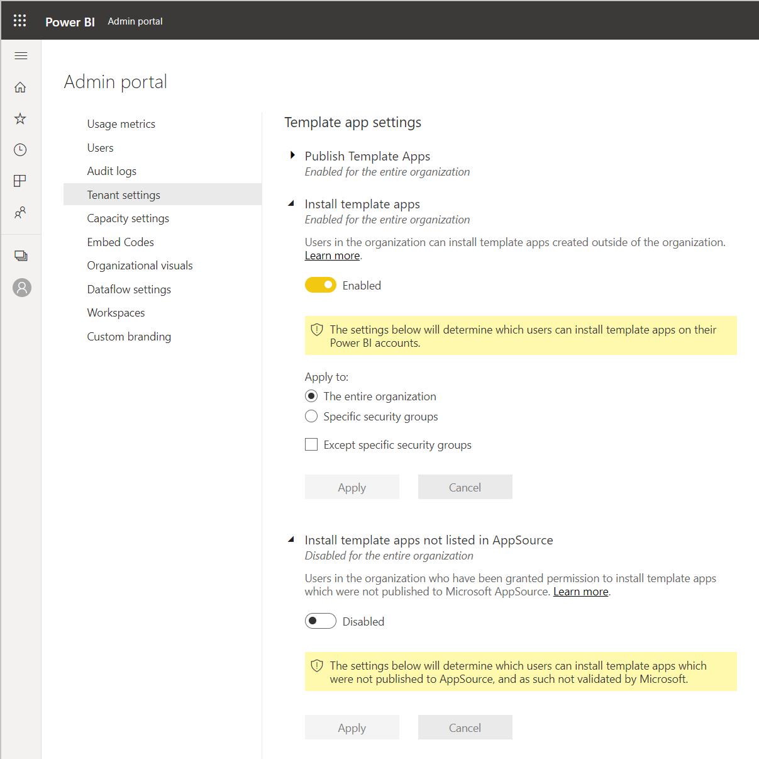
Template App Governance
Control who can install 1st or 3rd party apps from:
AppSource (default on)
Direct links (default off)
Control who can publish template apps outside the organization (default off)
© 2022 Microsoft All rights reserved.

Slide 56
Demo
Broadening the Reach of Power BI
© 2022 Microsoft All rights reserved.

Slide 57
Automating Power BI Administration
© 2022 Microsoft All rights reserved.

Slide 58
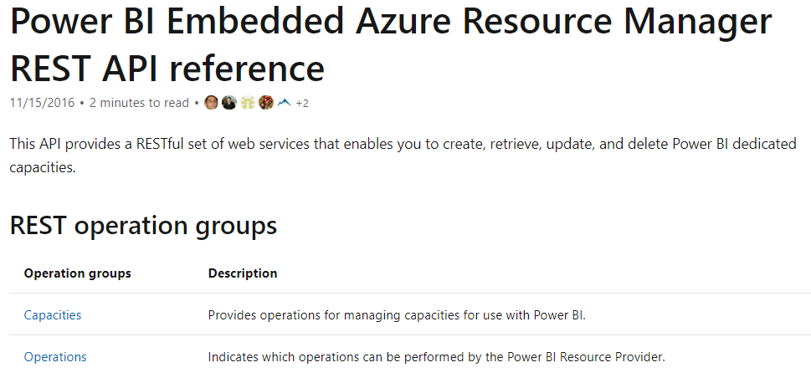
REST API for Power BI Dedicated Capacities
Used to manage and interact with the Power BI dedicated capacities
© 2022 Microsoft All rights reserved.

Slide 59
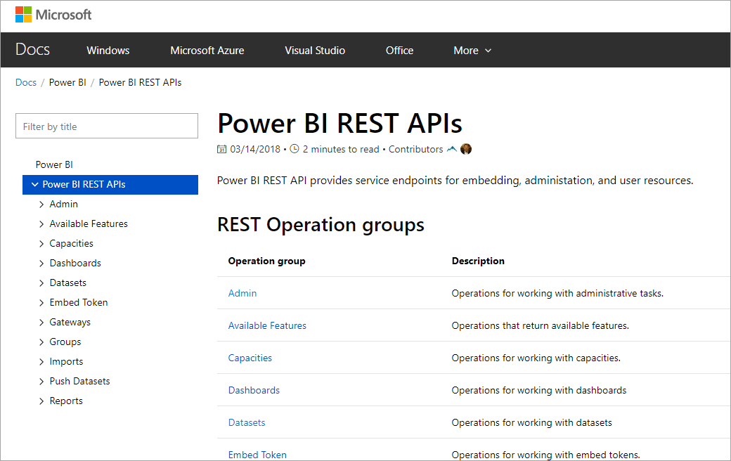
REST API – Power BI Service
Used to manage and interact with the Power BI Service
© 2022 Microsoft All rights reserved.

Slide 60
APIs to Monitor Email Subscriptions
Admin able to retrieve a list of subscriptions of impacted reports and notify subscribers
3 separate APIs provide administrators with a list of subscriptions of a given report, a dashboard, or a Power BI user
New APIs retrieve Power BI reports that are shared either with the whole organization or with the world via publish to web.

Slide 61
Admin APIs (public preview)
Enhanced visibility into user access and permission levels
Retrieve user and permission information for most Power BI assets
Produce access reports on demand
Automate and schedule reviews
Workspace Scanner API with User Permission Extension
Gives you user access information for various Power BI assets across all workspaces
Who has Access to an Asset API
Spot check access rights for a particular asset

Slide 62
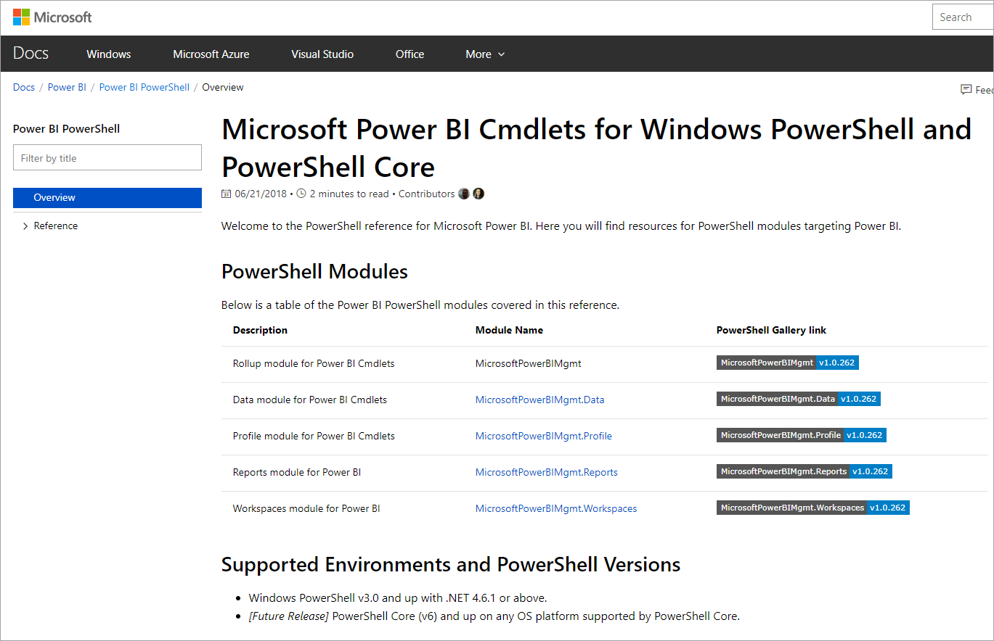
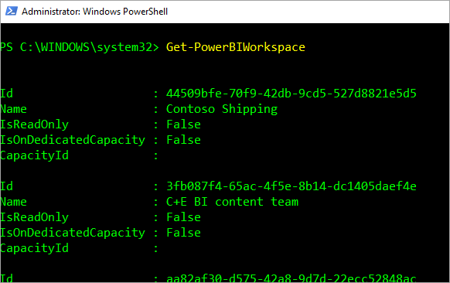
Microsoft Power BI CMDlets for Windows PowerShell & PowerShell Core
Power BI Cmdlets available to interact with service
© 2022 Microsoft All rights reserved.

Slide 63
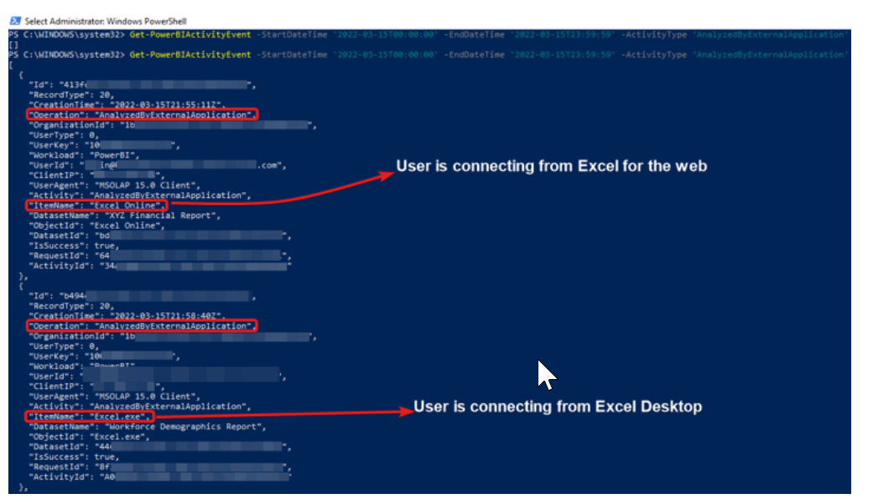
Admin Monitoring with PowerShell
Monitor usage of Power BI datasets in Excel with PowerShell
Open PowerShell and run the Get-PowerBIActivityEvent cmdlet

Slide 64
Install and Use the Power BI CMDlet
Install-Module -Name MicrosoftPowerBIMgmt
Connect-PowerBIServiceAccount
Get-PowerBIWorkspace
Get-PowerBIWorkspace -Scope Organization
Reference:
https://docs.microsoft.com/powershell/power-bi/overview?view=powerbi-ps
© 2022 Microsoft All rights reserved.

Slide 65
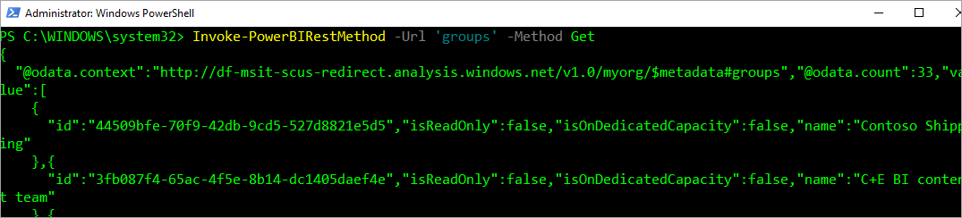
Testing REST API Calls
Use Invoke-PowerBIRestMethod to call REST APIs without overhead
No need to code Azure AD Authentication
No need to configure an App Registration!!!
Invoke-PowerBIRestMethod -Url 'groups' -Method Get
© 2022 Microsoft All rights reserved.

Slide 66
Scripting Typical Admin Tasks
List content (workspaces, dashboards, reports, datasets)
Write the list to CSV
Workspace management
Find datasets for a given data source
Resolve Power BI Error (show error information)
Call other REST APIs
Get the Access Token
List gateways
© 2022 Microsoft All rights reserved.

Slide 67
Demo
Automating Power BI Administration
© 2022 Microsoft All rights reserved.

